Slide 1

AZECA Early Childhood Day at the Legislature
February 15, 2018

Slide 2
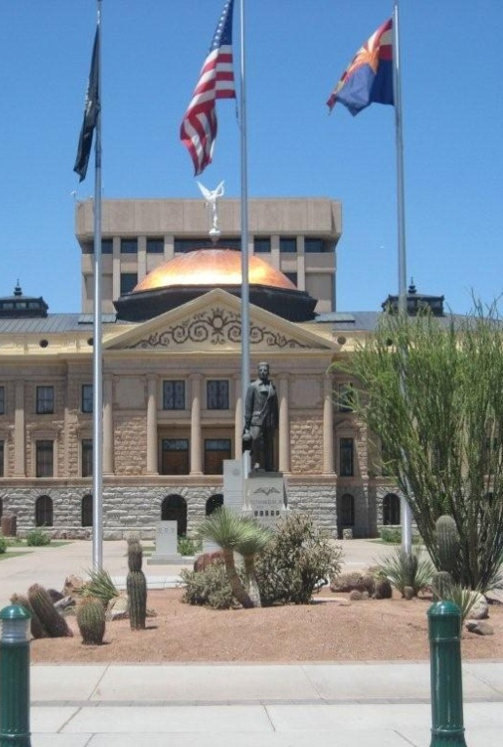
The Details

Slide 3
What you’re about to learn
Event Agenda
Location
How to schedule a meeting with your legislator on Early Childhood Day!
How to follow and submit your opinion on legislation
How to Register

Slide 4
Schedule of Events
8am-10am: Registration along with coffee and breakfast burritos
10am-12pm: Meetings with legislators
The Senate Education Committee is scheduled to meet at 9am, which you are welcome to attend
You may also visit the Capitol Museum , go on a tour and learn more about how to get involved while at the event
For more information on the schedule visit www.azeca.org

Slide 5
Location
Arizona State Capitol Rose Garden
  Directly North of Old Capitol Building
1700 W. Washington St. Phoenix, 85007
The best places to park are the unrestricted lots across from the House and Senate off Adams and Jefferson Streets:
  https://azleg.gov/alispdfs/council/CapitolMallParkingMap.pdf
https://www.azleg.gov/location/

Slide 6
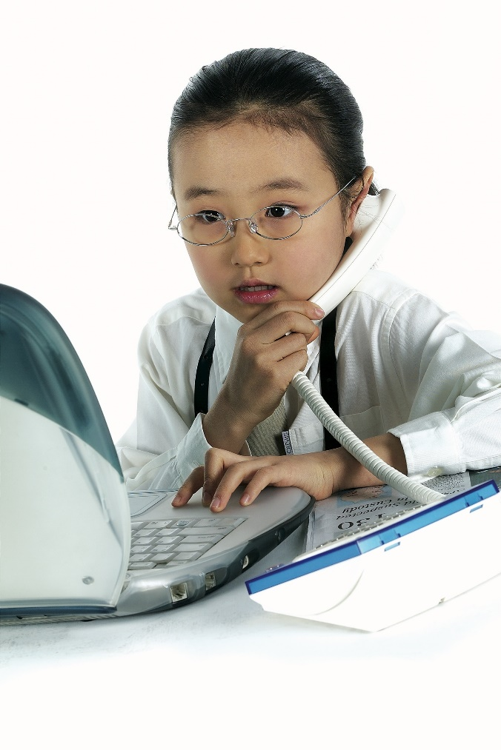
Scheduling a Meeting with your Legislator

Slide 7
Scheduling a Meeting
Step 1:
Find your Legislator/Legislative District
Go to https://azredistricting.org/districtlocator/
15

Slide 8
Scheduling a Meeting
Step 2:
Go to either:
  https://www.azleg.gov/MemberRoster/?body=S
  https://www.azleg.gov/MemberRoster/
Find the legislators in the district you belong to.

Slide 9
Scheduling a Meeting
Step 3:
You may call or email a legislator’s office to schedule a meeting
If you don’t hear back with-in 24 hours call again!

Slide 10

Preparing for the Meeting
Call your legislator about 10-15 days before Early Childhood Day!

Slide 11

Preparing for the Meeting
Script:
“Hello, my name is __________ from ________ organization. I am interested in scheduling a meeting with Senator/Rep. _____________ during EC Day to discuss how we can work together on _______ policies.”

Slide 12
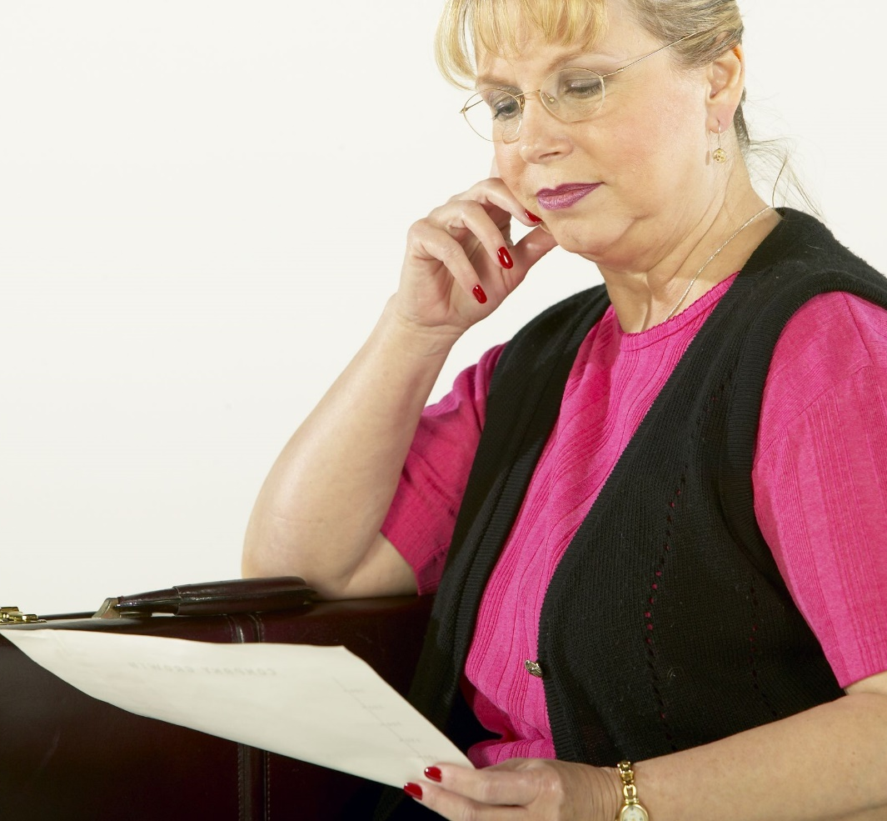
Preparing for the Meeting
Be sure to explain what you want to cover (early childhood in general or some specific piece such as literacy, home visitation etc.)
How many plan to attend?
Remember that the legislator may need to change times or have a staff member take his/her place
On the day of the event, AZECA will provide participants with talking points and general early childhood information that can be used.

Slide 13

Preparing for the Meeting
Let us know if you are successful in getting a meeting with a legislator by emailing us at kmurphy@achildren.org

Slide 14
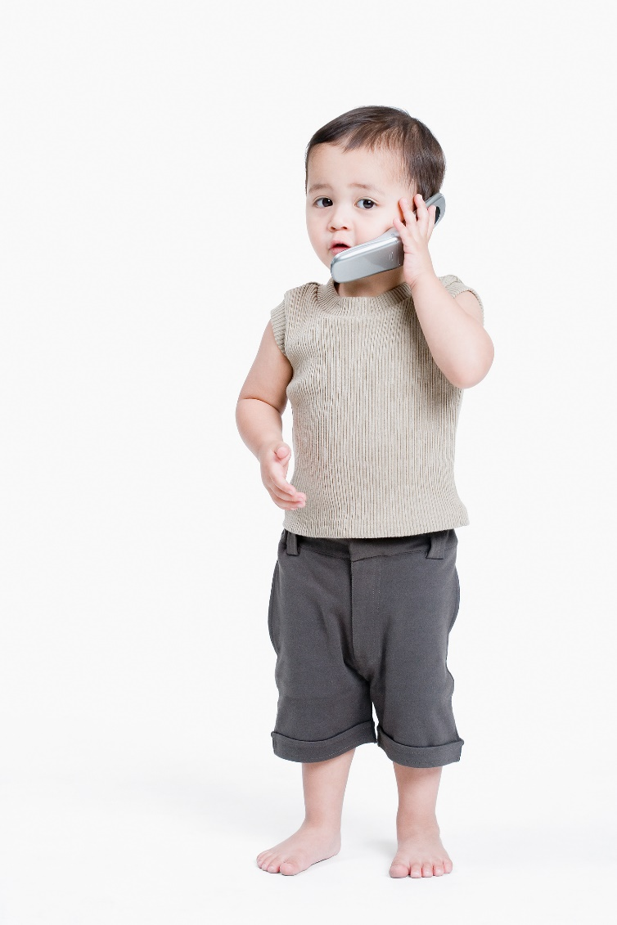
KEEPING INFORMED AND REGISTERING YOUR OPINION

Slide 15

ALIS
This is
Arizona
Legislative
Information
System
ALIS
www.azleg.gov

Slide 16

How to use ALIS
1. Simple bill query
2. In depth notifications

Slide 17
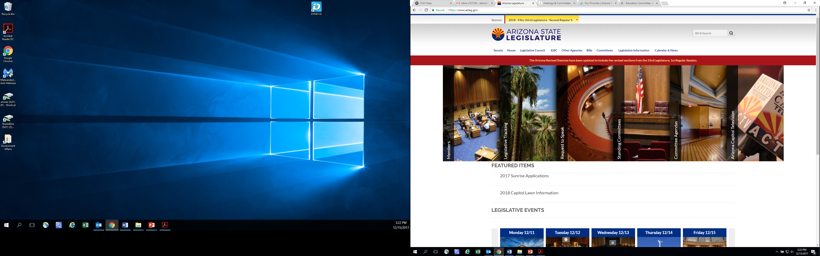
Simple query (Search for a bill number)

Slide 18
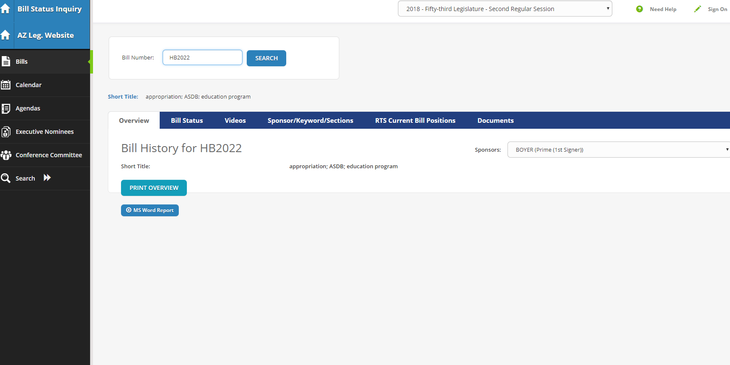
Click on these to learn more…

Slide 19
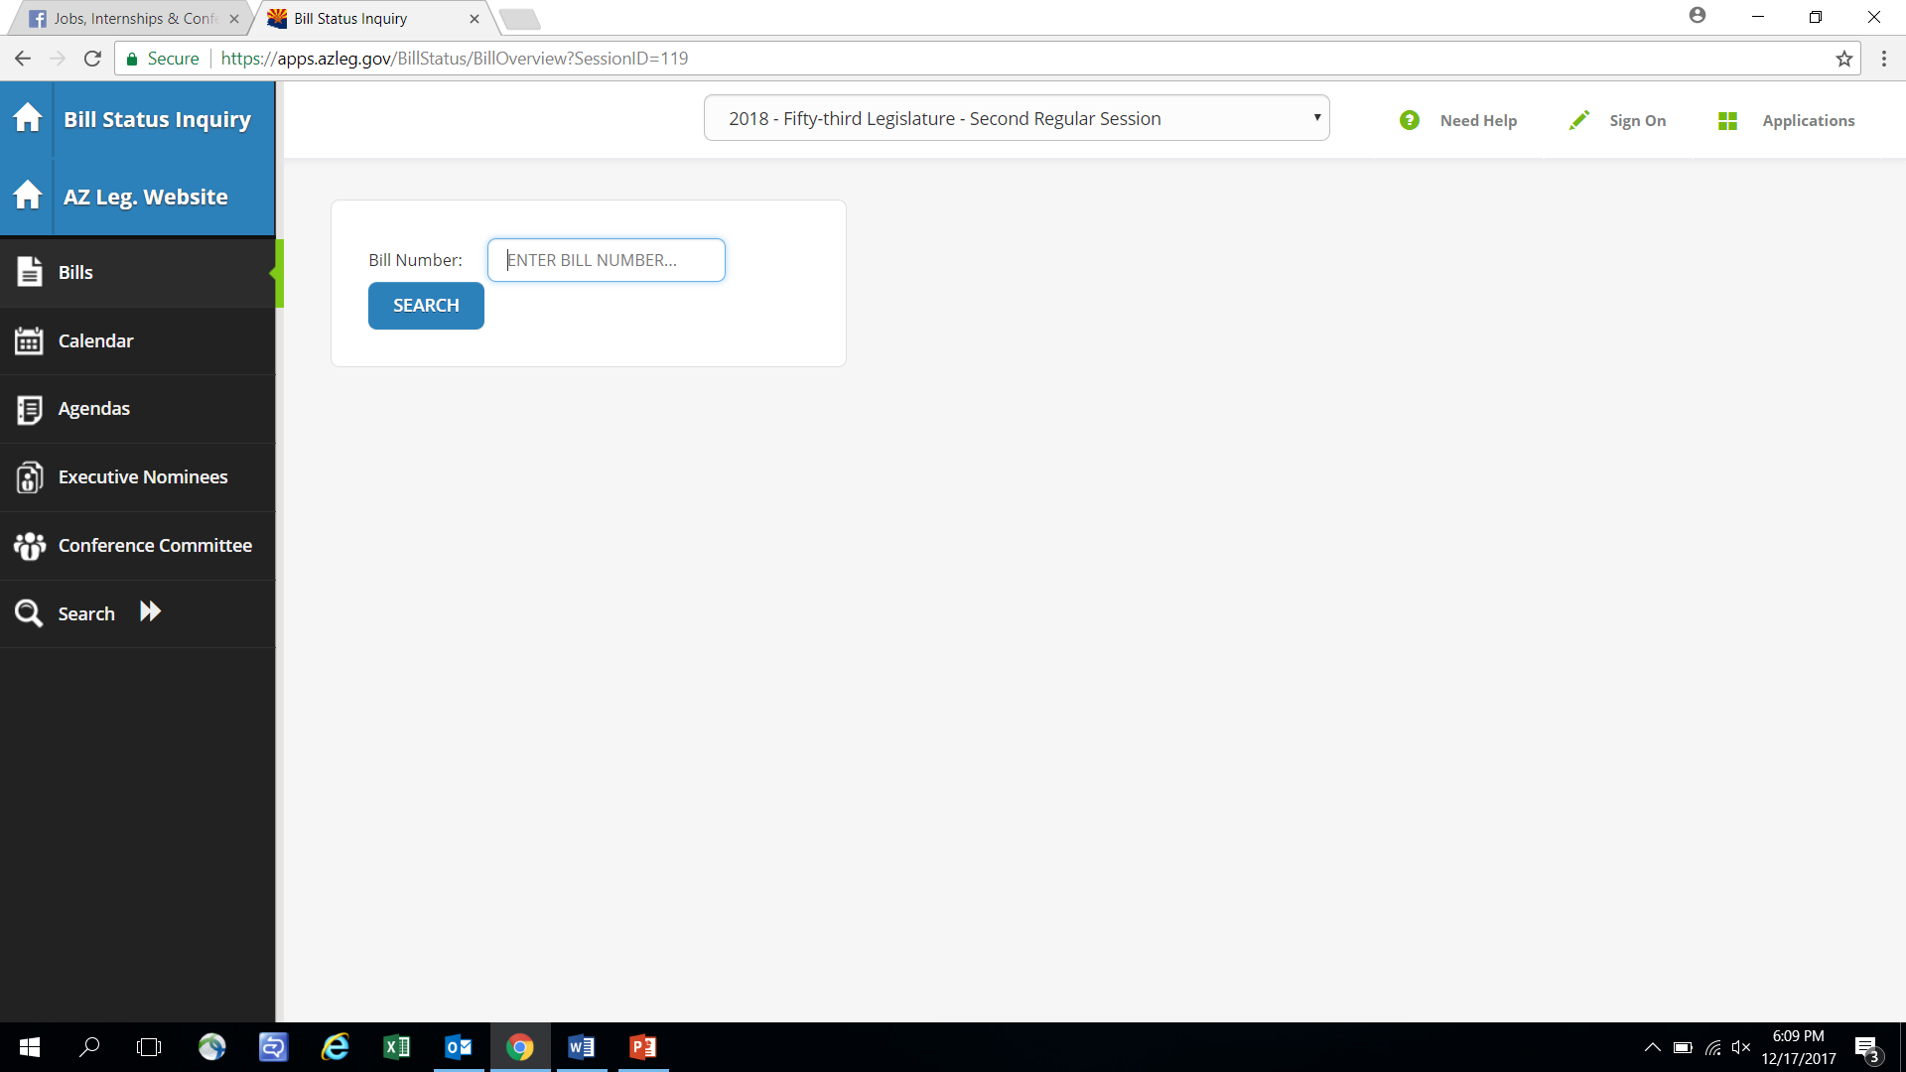
In depth notifications
On www.azleg.gov go to “bills” followed by “bill tracking”. On the page show here, click “sign on”

Slide 20
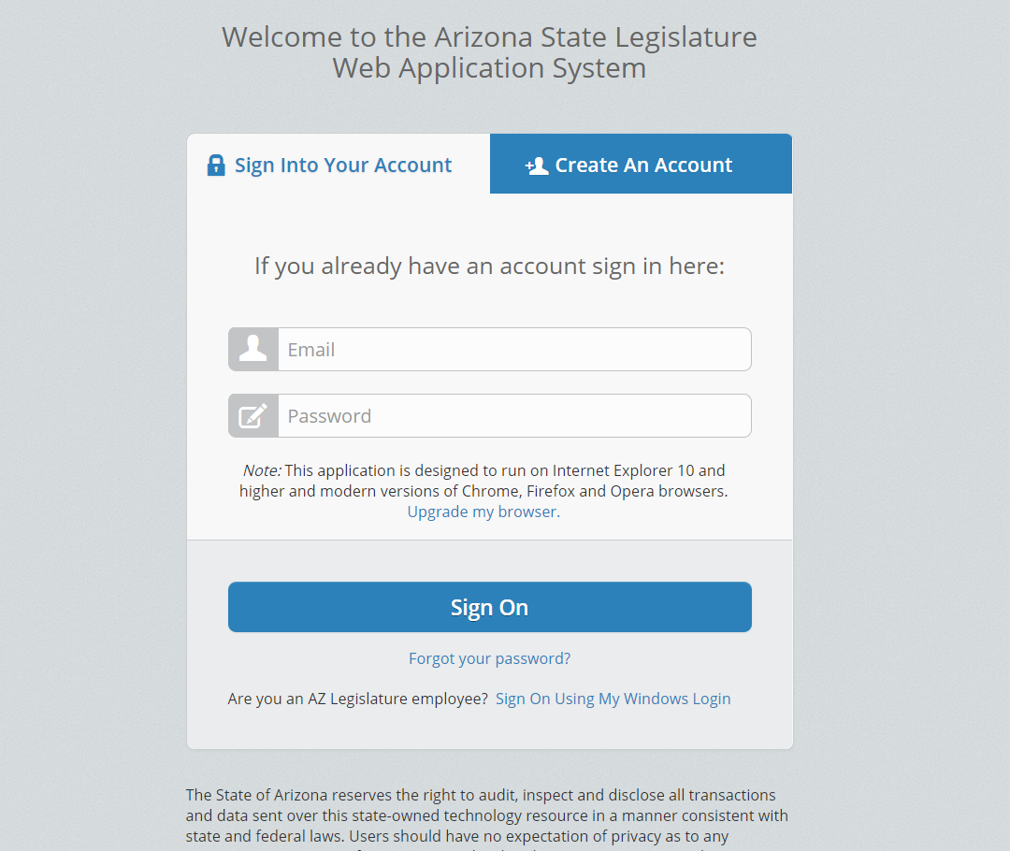
What’s next?
Sign on or create new account

Slide 21
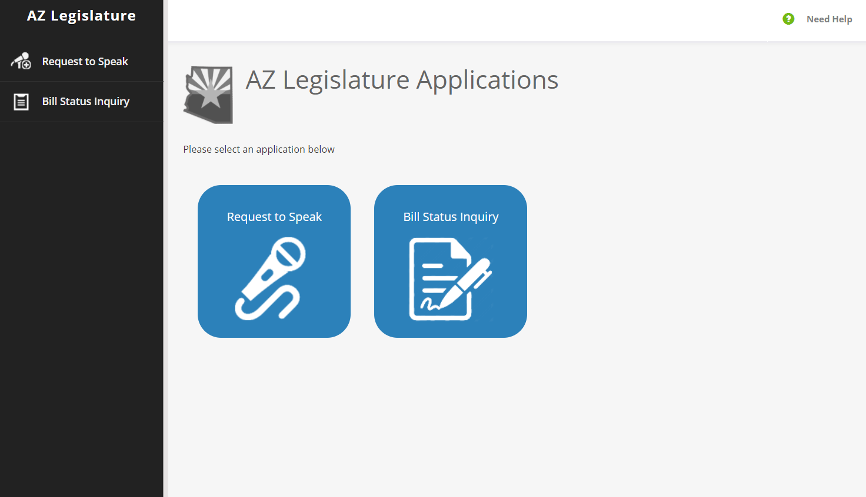
Select “Request to Speak” (you don’t actually HAVE to speak!). This will allow you to track and voice your opinion on any bill!

Slide 22
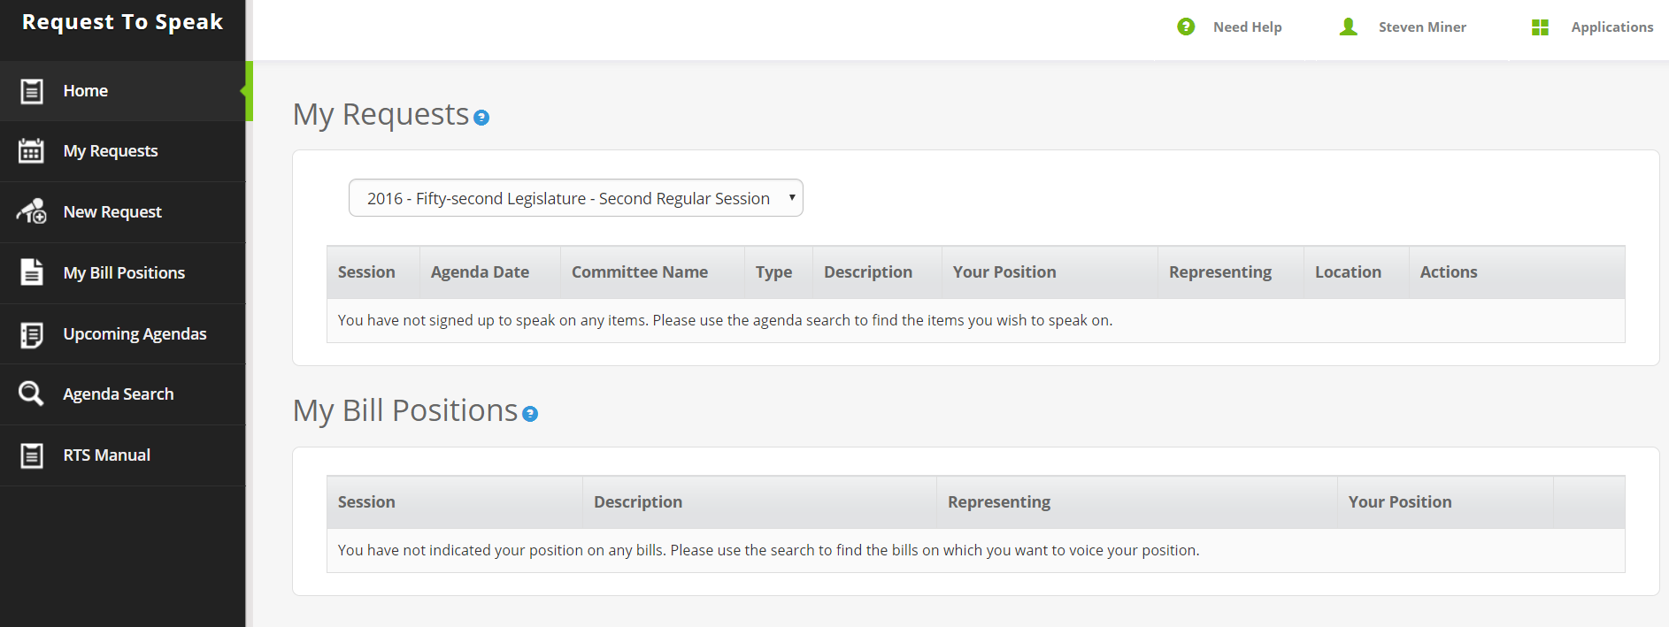
Select “My bill positions” to choose whether you are for, against or neutral toward a particular bill.

Slide 23

How can you utilize ALIS?
Track Bills
Track Nominees
Track Committees
Agendas
Calendars

Slide 24
Register for Early Childhood Day at the Legislature
Visit www.azeca.org

